Slide 1
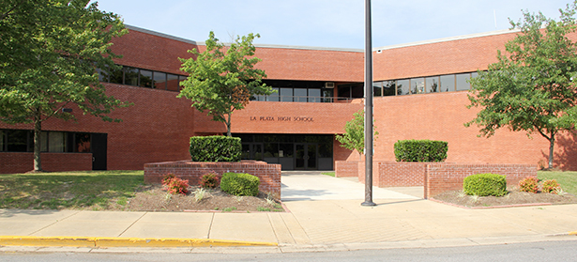
Class Rules
Have respect
Be on task
Some details about warm-ups:
Due the day they are assigned
Might be graded at any time
You can ONLY make them up if you have an excused absence and fill in a late work form.
School rules:
Stay at your seat until dismissed.
Bring a pass if you come late to class

Slide 2
BYOD is optional in schools. If you want to continue to have BYOD at La Plata High School: There should NOT be students using phones during down time or listening to music during a normal lesson. Students ARE permitted to use their phones before 7:30am, during PRIDE Time, and at the end of the day. All other times are ONLY for approved classwork activities that have a start and an end point . Phones should be out of sight.

